Slide 1

Comp-229-Assignment4
Name: Md Rashedul Islam
Id: 301118802
Sec:001

Slide 2
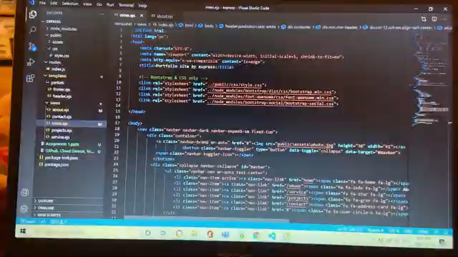
Explanation About Assignment 2 https://youtu.be/_7qgDCx-Ga4

